Slide 1
Lab#4-1 Linear Feedback Shift Register(LFSR) 1/3

Slide 2
Lab#4-1 Linear Feedback Shift Register(LFSR) 2/3

Slide 3
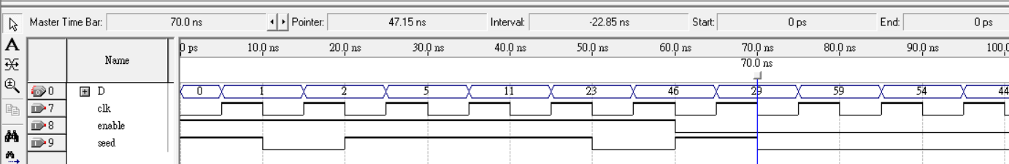
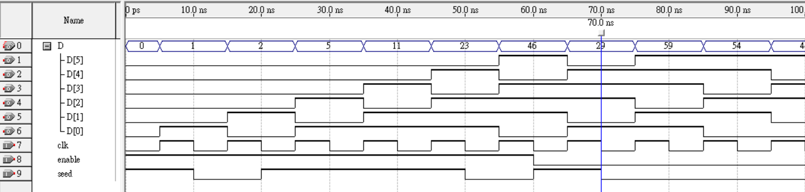
Lab#4-1 Linear Feedback Shift Register(LFSR) 3/3

Slide 4
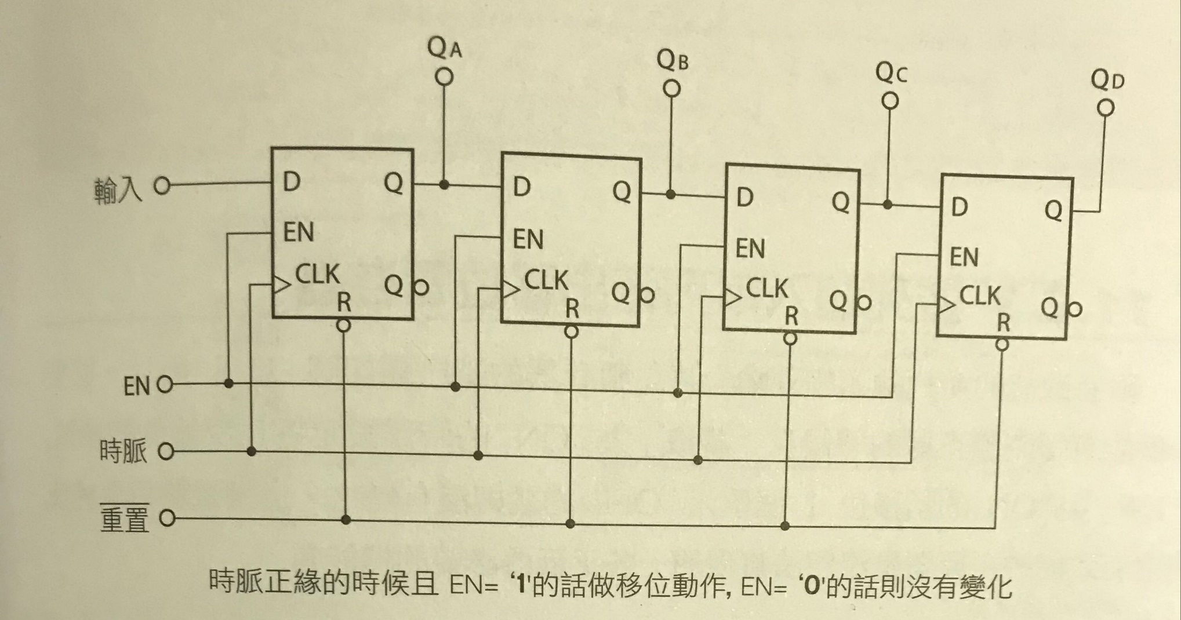
Lab#4-2 serial in parallel out shift register, SIPO 1/3 enable input !!!

Slide 5

Lab#4-2 serial in parallel out shift register, SIPO 2/3 enable input !!!

Slide 6
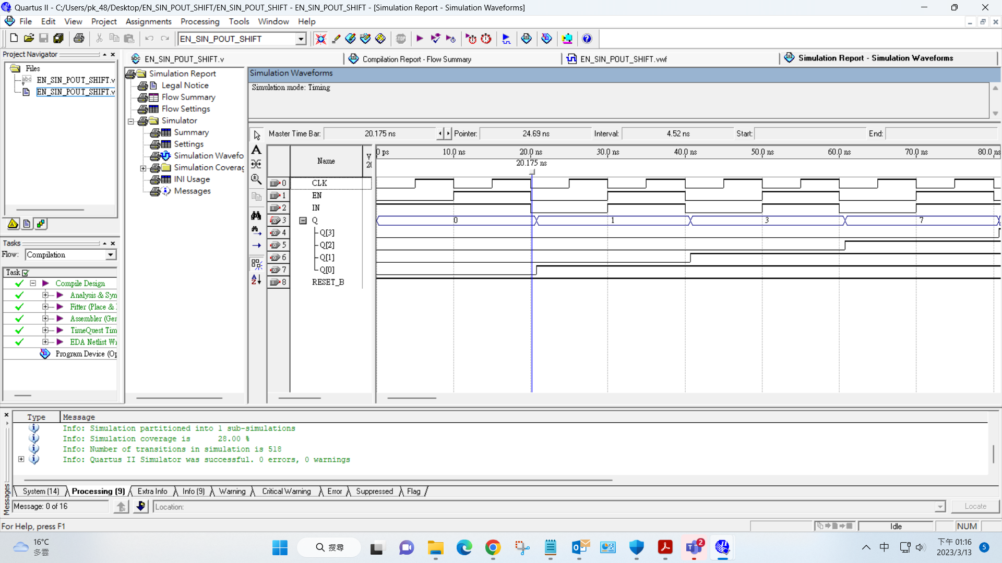
Lab#4-2 serial in parallel out shift register, SIPO 3/3 enable input !!!

